Slide 1
Intro To Programming JavaScript

Slide 2
Brief Summary Of Chapter 6
Embedding JavaScript in HTML
IF, ELSE and ELSE IF Statements
Types of Loops
Chapter 6: Conditionals and Loops

Slide 3
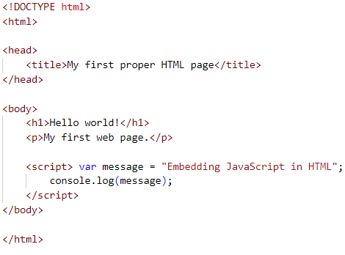
Embedding JavaScript in HTML means including JavaScript code directly within an HTML document using <script> tags. This allows you to add interactive features and dynamic content directly on the web page.
(B-p117 & L-p90)
Embedding JavaScript in HTML?

Slide 4
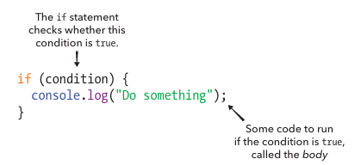
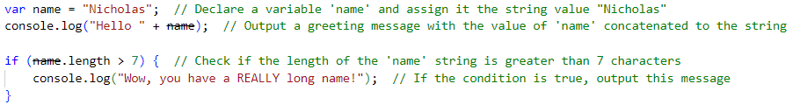
An "if" statement is a basic decision-making tool in programming. It checks whether a certain condition is true. If the condition is true, the program will perform a specific action. If the condition is false, the action is skipped, and the program moves on to the next part of the code.
EXAMPLE: (B-p119 & L-p92)
IF, ELSE and ELSE IF Statements

Slide 5
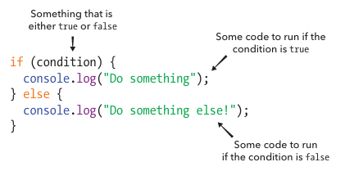
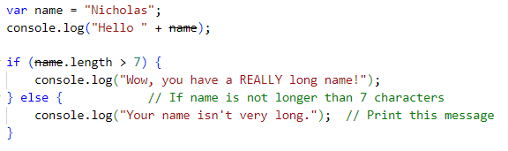
The "else" statement works alongside the "if" statement to handle situations where the initial condition is false. It provides an alternative action for the program to perform when the condition in the "if" statement is not met. This way, the program can react differently based on whether the condition is true or false.
EXAMPLE: (B-p120 & L-p93)

Slide 6
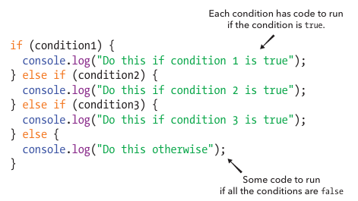
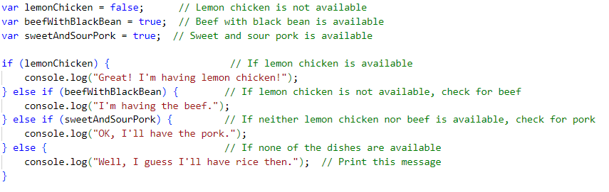
The "else if" statement comes into play when there are multiple conditions to check. After the initial "if" statement, it allows the program to test additional conditions. If the first condition is false, the program checks the "else if" condition, and if that’s true, it performs the corresponding action. If none of the conditions are true, the program will go to the "else" block, if one is provided, to handle the situation.
EXAMPLE: (B-p121 & L-p94)

Slide 7
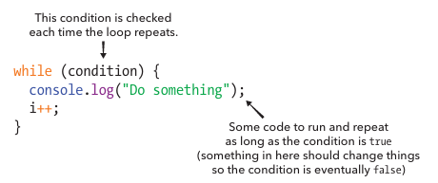
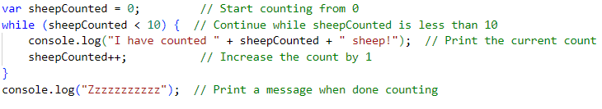
A "while loop" keeps running as long as a condition is true. If the condition is false at the start, the loop won’t run at all.
EXAMPLE: (B-p124 & L-p97)
Types of Loops

Slide 8
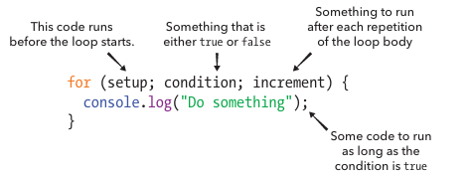

A "for loop" repeats code for a specific number of times. You set the starting point, the condition to stop, and how to increase the count, all in one line.
EXAMPLE: (B-p126 & L-p999)

Slide 9
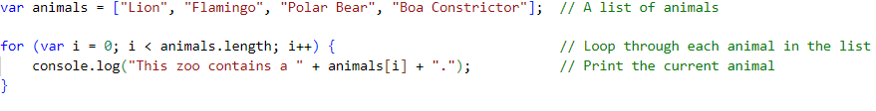
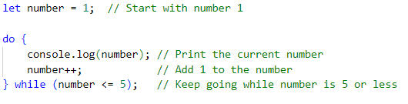
Using for loops with Arrays and Strings:
EXAMPLE: (B-p127 & L-p100)
DO-WHILE LOOP:
A "do while loop" is similar to a "while loop" but guarantees that the block of code will run at least once. It executes the code first and then checks the condition to decide whether to continue with additional iterations. This ensures that the loop’s body is executed before the condition is tested.
EXAMPLE:

Slide 10

Do all try outs and Programming Challenges then upload to github.
Page (B-123 & L-96)
Page (B-129 & L-102)
Page (B-130 -131 & L-103 - 104)
Practice Exercises

Slide 11
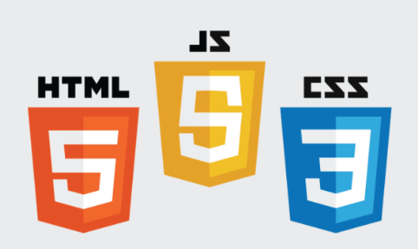
End Of Chapter 6

